Slide 1


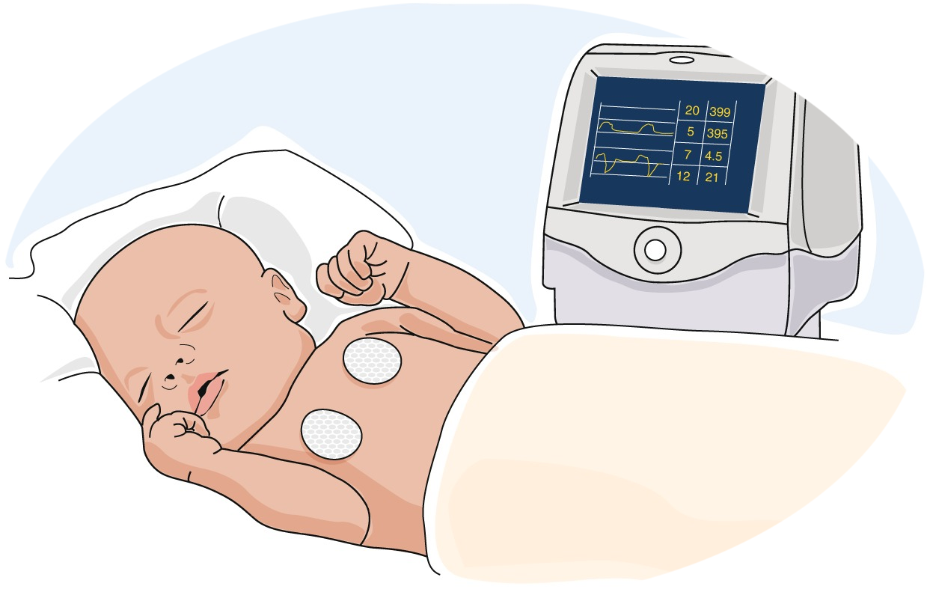
CHILD HEALTH MONITORING SYSTEM
HEALTHCARE PROTECTION

Slide 2

01 Introduction
02 Our team
03 Project Slide

Slide 3

Aims to enhance child healthcare by utilizing advanced technology.
Monitors vital signs, activity levels, and crucial health indicators.
Provides real-time data for parents and healthcare providers.
Alerts caregivers promptly if any concerning signs are detected.
Offers continuous 24/7 health monitoring for children.
Provides parents with peace of mind regarding their child's well-being.

Slide 4








AMAN KUMAR JHA
ANUSHKA JAIN
LOKENDRA SINGH RAJAWAT
KARTIK SINGH CHAUHAN
SUMIT SAMADHIYA
SURYANSH SINGH

Slide 5

PROJECT SLIDE
CHILD HEALTH MONITORING SYSTEM

Slide 6
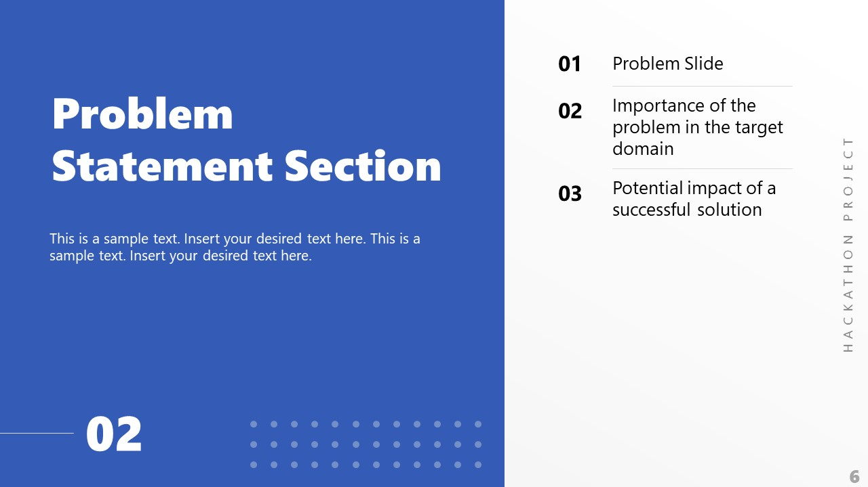

Slide 7

Limited Monitoring Capability
Problem 01
Lack of Parental Oversight.
Problem 02
Limited Wellbeing Information.
Problem 03
Privacy and Security Concerns.
Problem 04
Real-time Monitoring Hurdles.
Problem 05
Alert and Notification Delays.

Slide 8
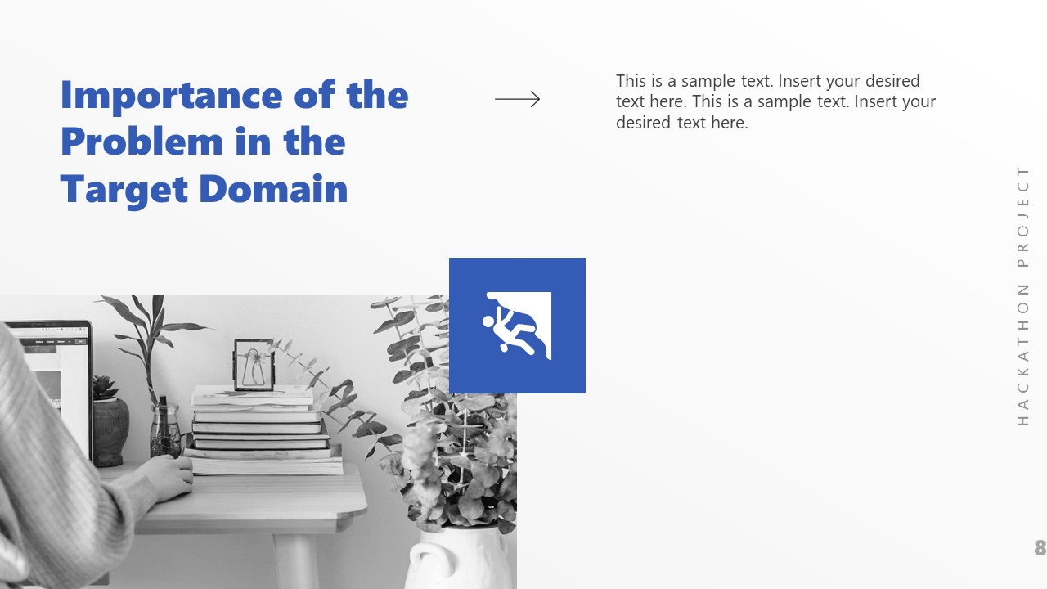
Challenge Against Time Intervention
The challenge lies in ensuring timely intervention for child health issues. Swift action is vital, as early detection through the system prevents health problems from worsening, demanding immediate medical attention and ultimately improving child health outcomes.

Slide 9
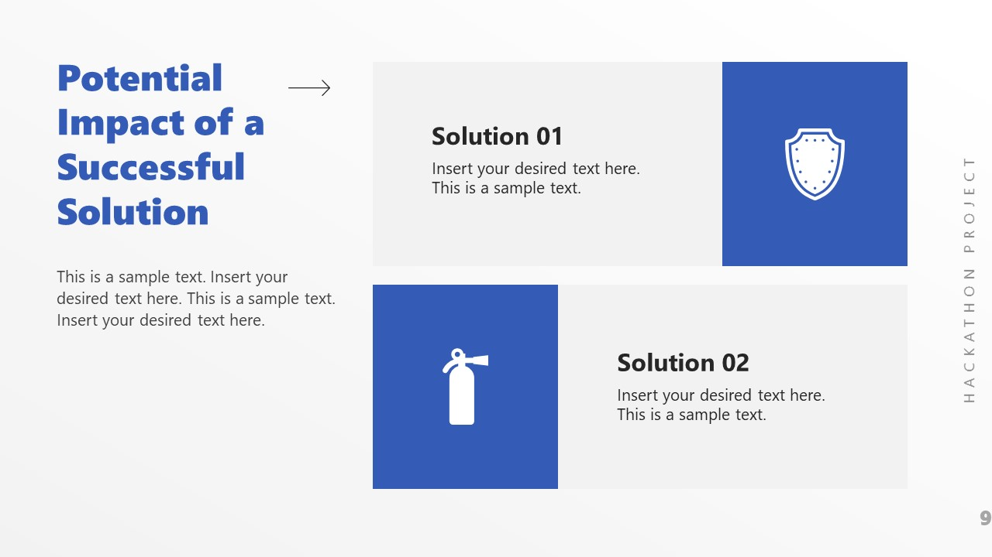
SOLUTION OF PROBLEM
The successful solution to the challenge of ensuring timely intervention for child health issues is the implementation of the Smart Child Health Monitoring System. This system utilizes advanced technology to continuously monitor vital signs and health indicators in real-time. When abnormalities are detected, immediate alerts are sent to parents and caregivers, enabling swift medical attention. This proactive approach prevents minor health concerns from developing into serious conditions and enhances overall child health outcomes

Slide 10

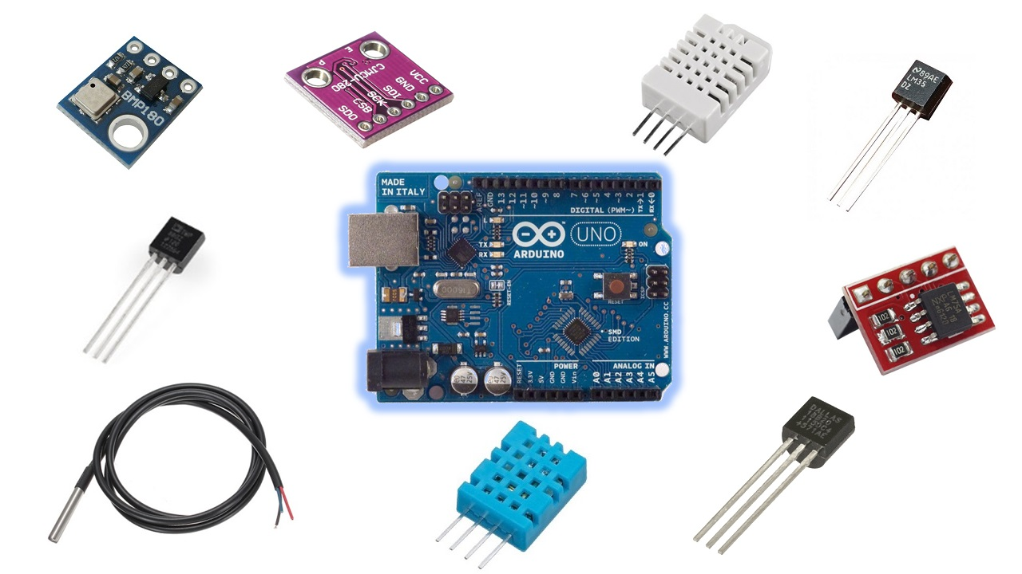
SENSORS USED

Slide 11
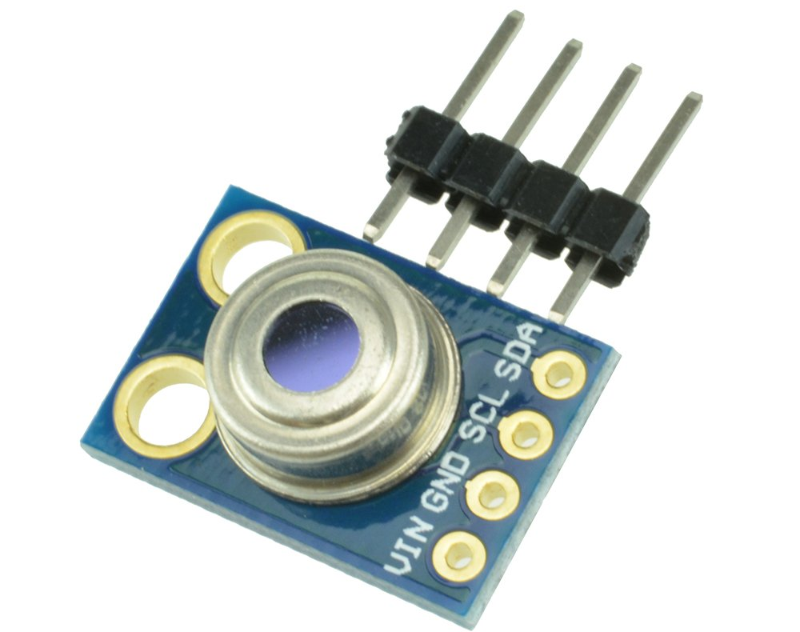
MLX90614
MLX90614 is an infrared temperature sensor measuring object temperature without contact, useful in various applications.

Slide 12
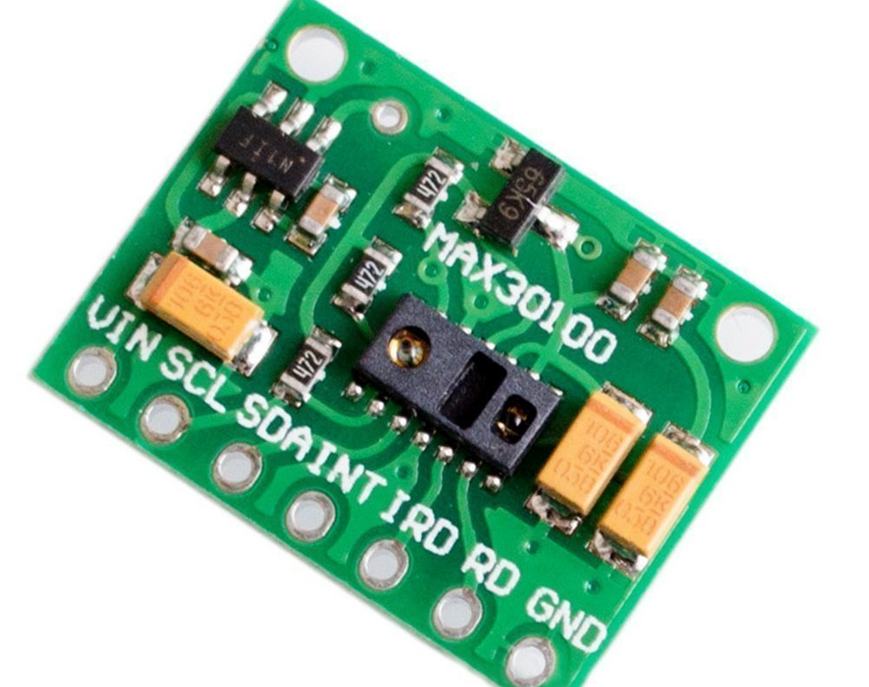
MAX30100
MAX30100 is a pulse oximeter and heart-rate sensor, measuring blood oxygen levels and heart rate noninvasively.

Slide 13
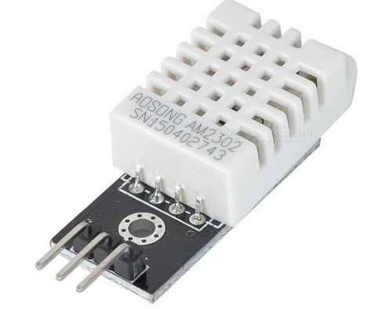
DHT22
DHT22 is a temperature and humidity sensor, providing accurate measurements for environmental monitoring applications.

Slide 14


Slide 15
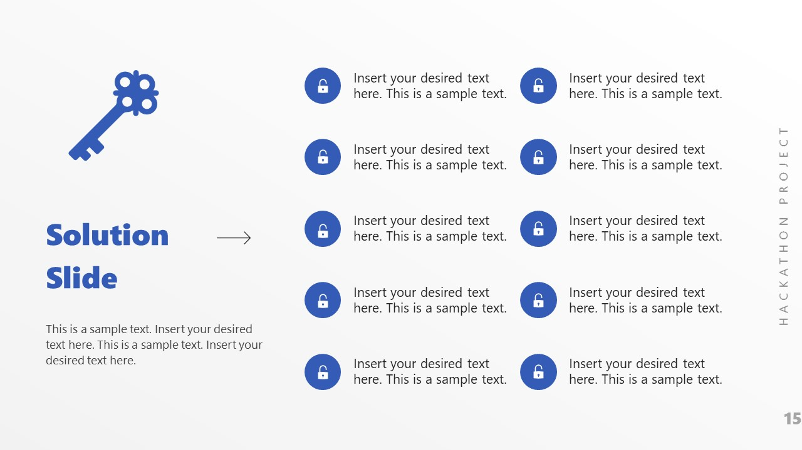
Early Detection of Health Issues:
Remote Monitoring:
Improved Communication with Healthcare Professionals:
Preventive Health Management
Peace of Mind for Parents

Slide 16
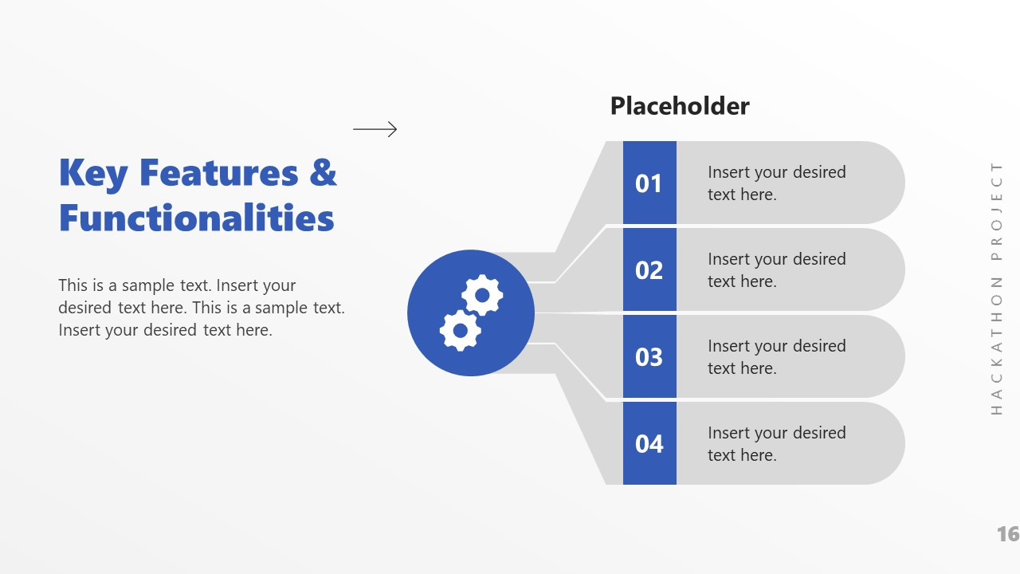
ENVIRNOMENT TEMPRATURE
BODY TEMPRATURE
PLUSE RATE
SpO2

Slide 17
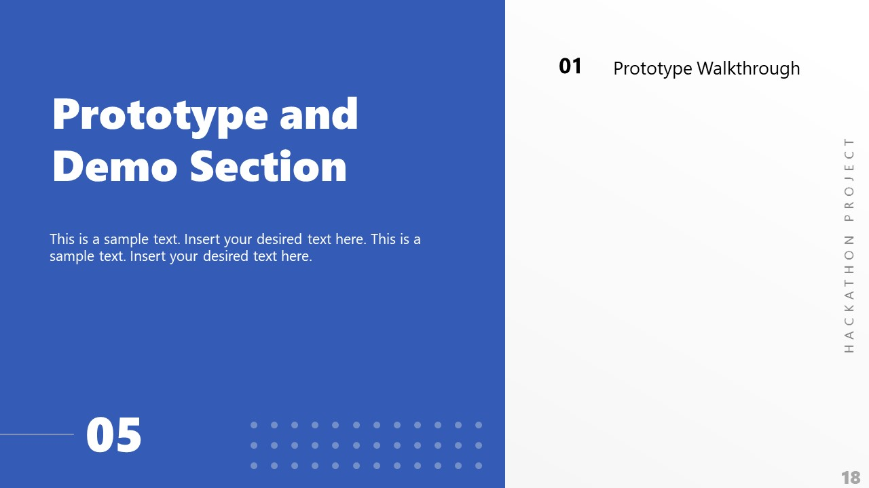

Slide 18
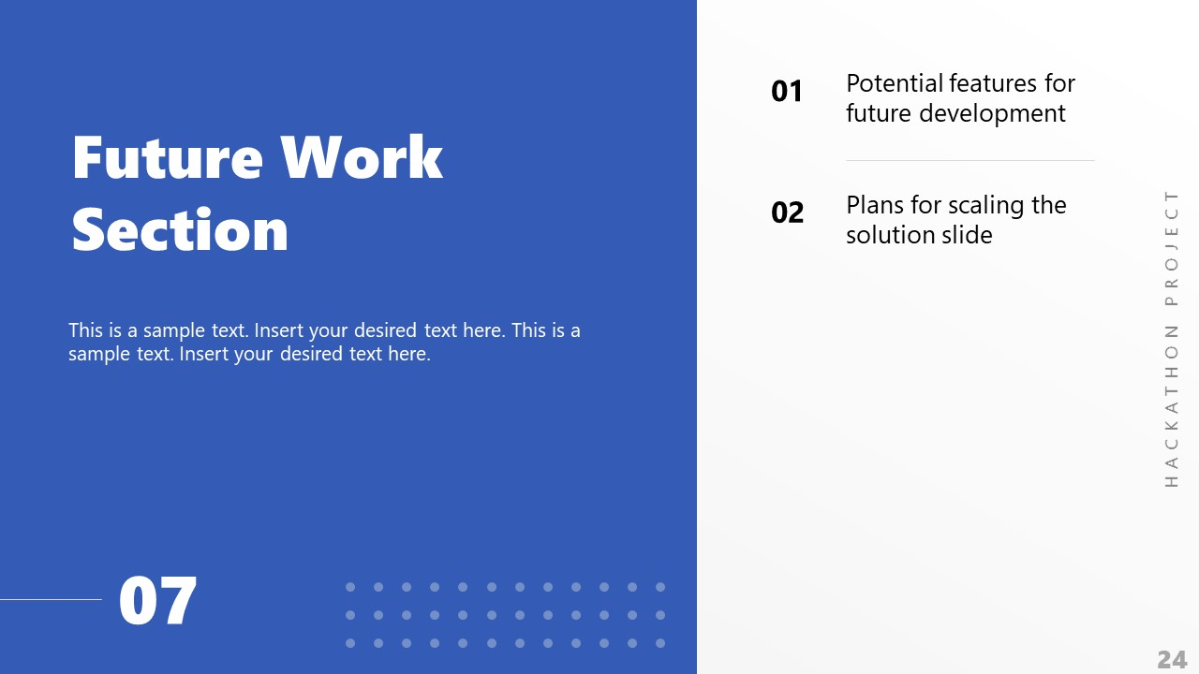


Slide 19
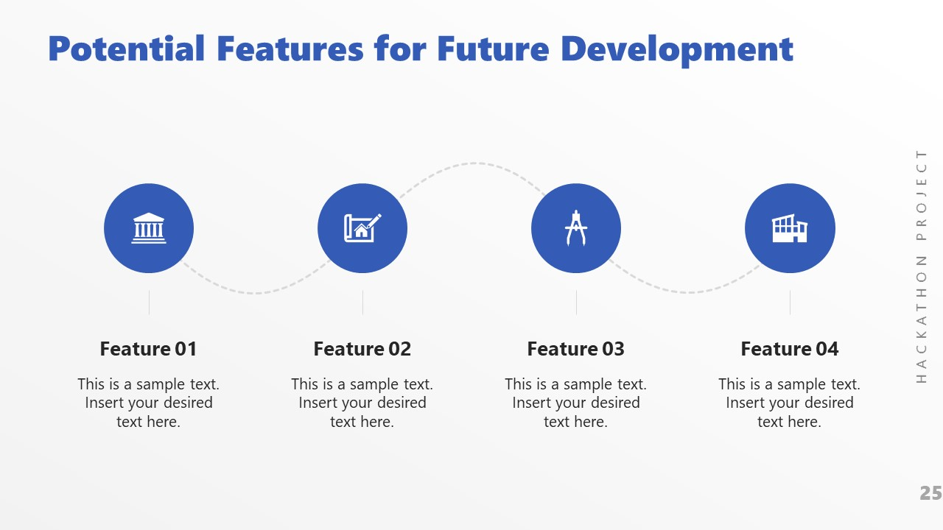
Data Privacy Enhancement
User Friendly Interface
Integration with wearables.
Behavioral Pattern Recognition

Slide 20

“The smart monitoring system has the potential to revolutionize child healthcare by providing real-time monitoring and alerts, improving access to healthcare services, and helping healthcare providers make more informed decisions. While there are challenges to implementing and adopting the system, the benefits are clear. By working together, healthcare providers and technology companies can ensure that children receive the best possible care. ”

Slide 21

s

